Slide 1
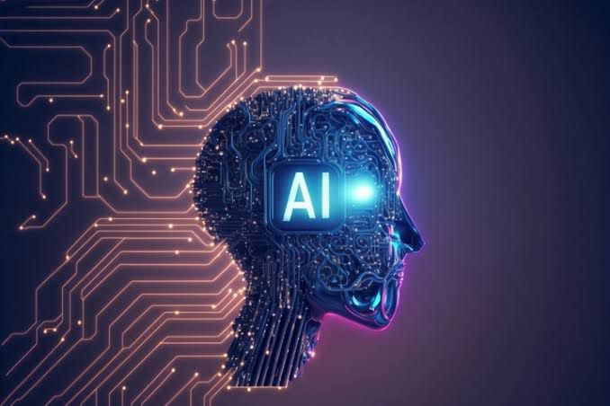
Artificial intelligence is the intelligence of machines or software, as opposed to the intelligence of humans or animals. It is also the field of study in computer science that develops and studies intelligent machines. "AI" may also refer to the machines themselves.

Slide 2
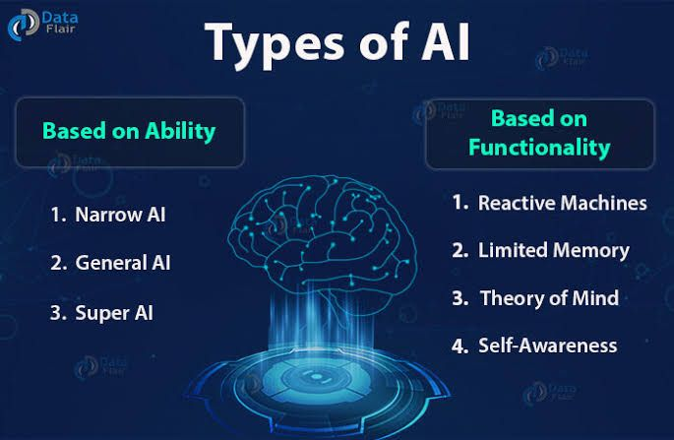
Artificial Intelligence can be divided in various types, there are mainly two types of main categorization which are based on capabilities and based on functionally of AI. Following is flow diagram which explain the types of AI.

Slide 3
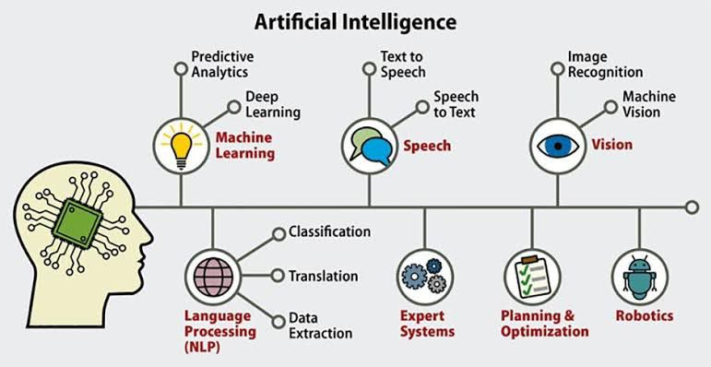
An AI tool is a software application that uses artificial intelligence algorithms to perform specific tasks and solve problems.AI tools can be used in a variety of industries, from healthcare and finance to marketing and education, to automate tasks, analyze data, and improve decision-making.

Slide 4
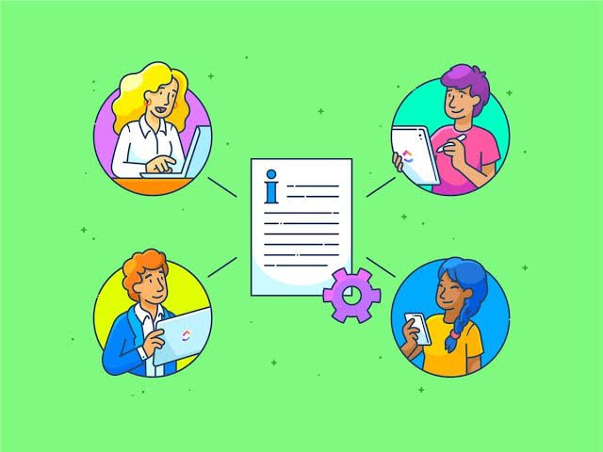
A text-to-text Generative AI is an AI that Generates text based on text input.

Slide 5
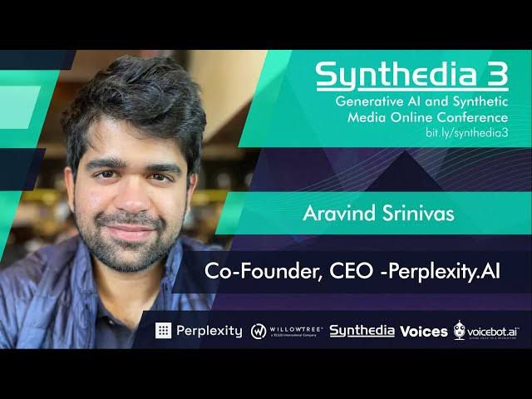

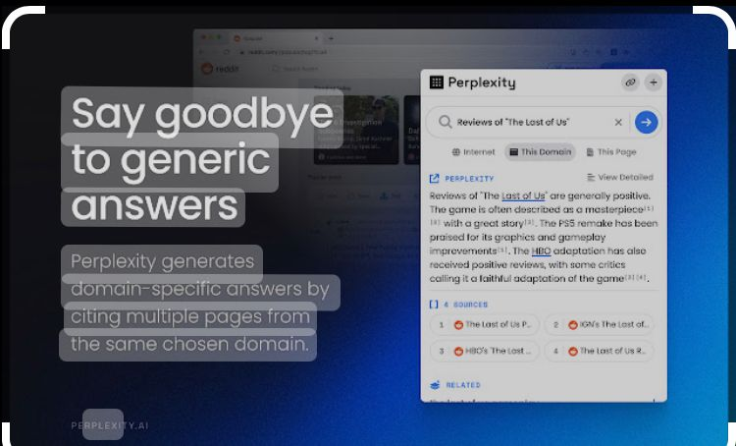
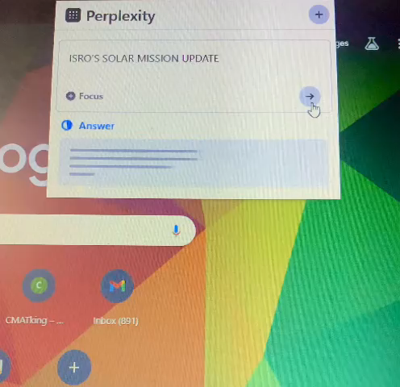
Perplexity is a measure used to evaluate the performance of language models. Perplexity is a statistical measure of how confidently a language model predicts a text sample.

Slide 6

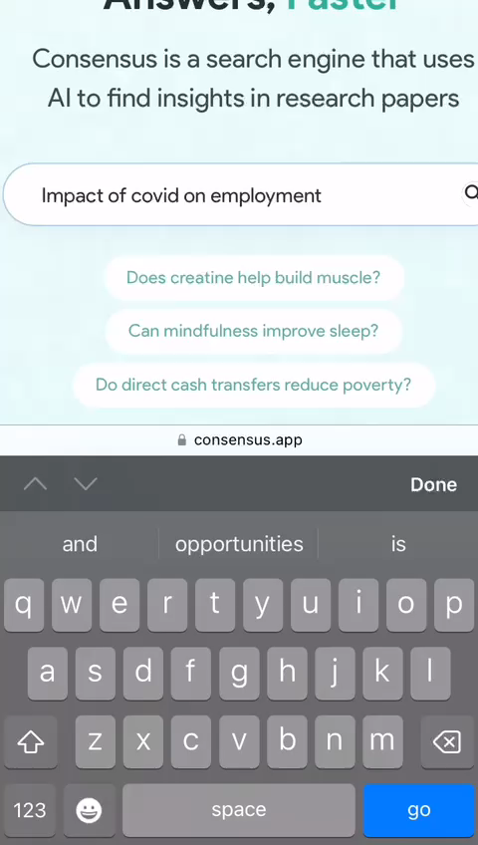
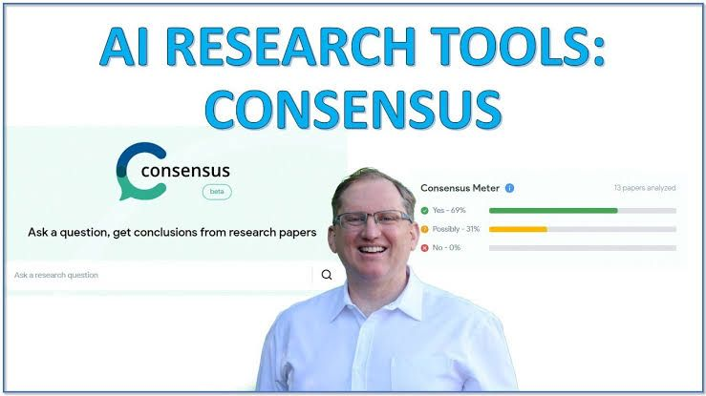
Consensus is a search engine. It uses AI to find research pieces for scientific study. Consensus AI provides evidence-based answers faster. It aims to make expert knowledge accessible and consumable for all.

Slide 7
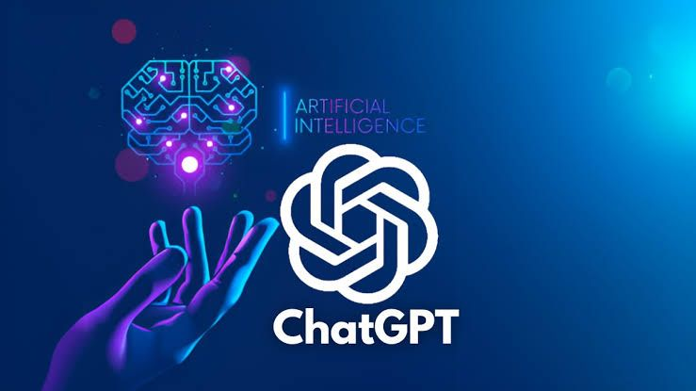

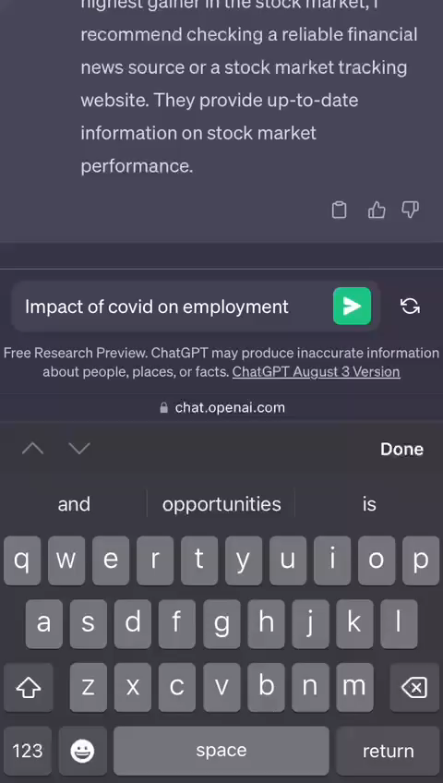
ChatGPT, which stands for Chat Generative Pre-trained Transformer, is a large language model–based chatbot developed by OpenAI and launched on November 30, 2022, which enables users to refine and steer a conversation towards a desired length, format, style, level of detail, and language used.

Slide 8
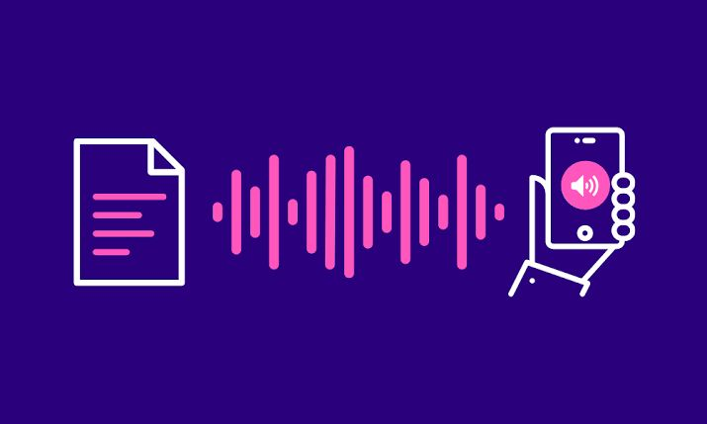
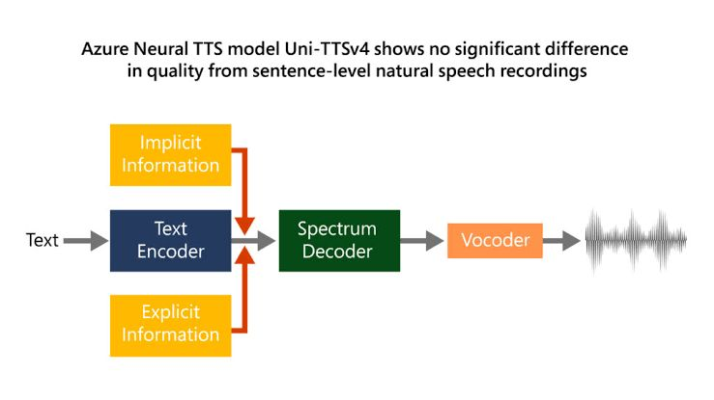
The text-to-speech (TTS) assistive technology uses artificial intelligence to translate information written in a human-readable form in one language into audio, voice, or speech with a human accent.

Slide 9
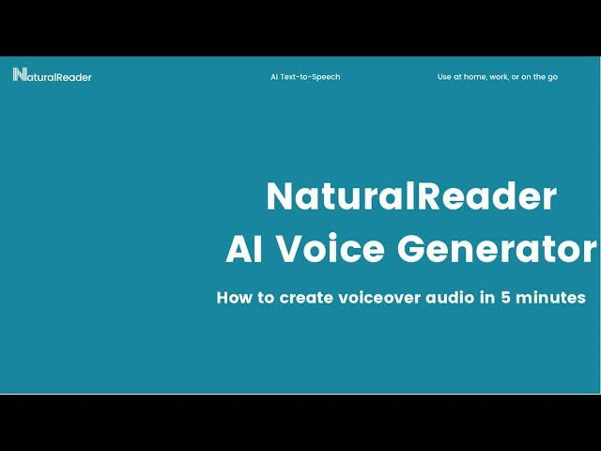
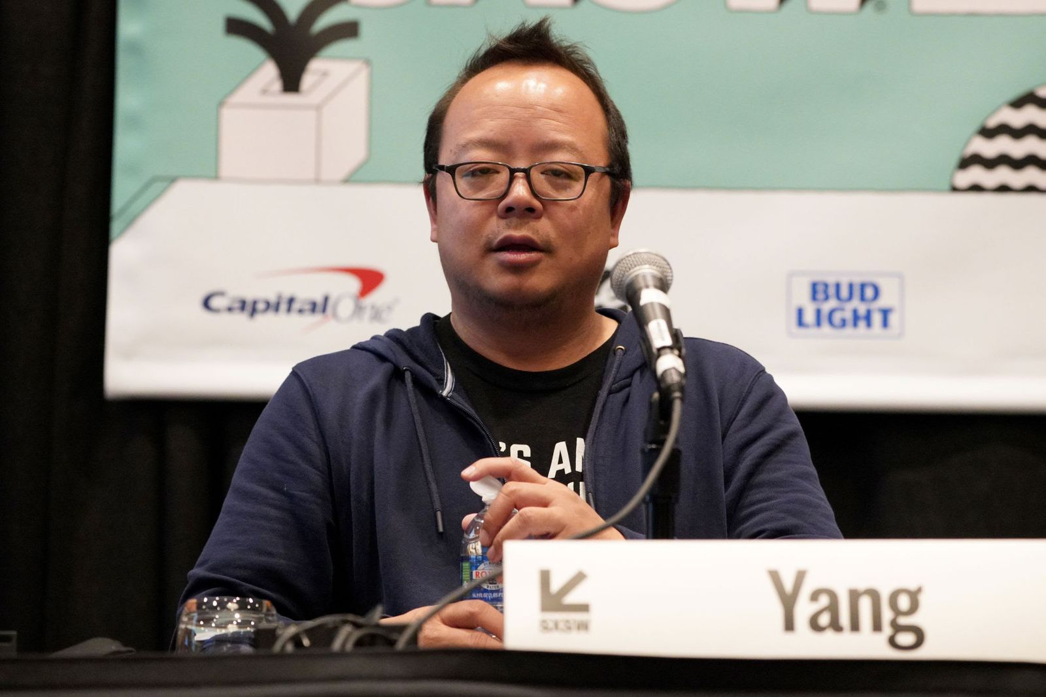
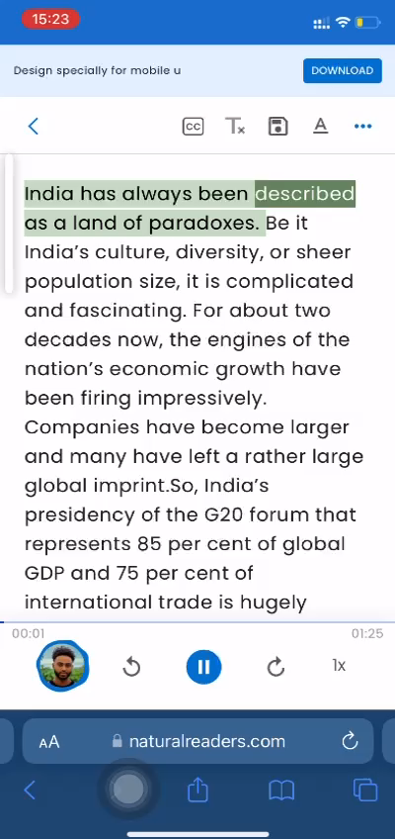
Jeff Yang found himself having troubles reading technical textbooks during his university studies. To help with his readings, he developed his own text-to-speech software. To help others with the same problem, Jeff published the first edition of NaturalReader.

Slide 10
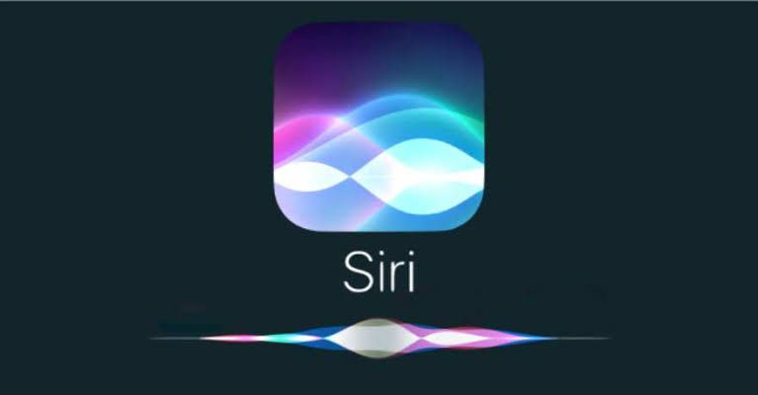
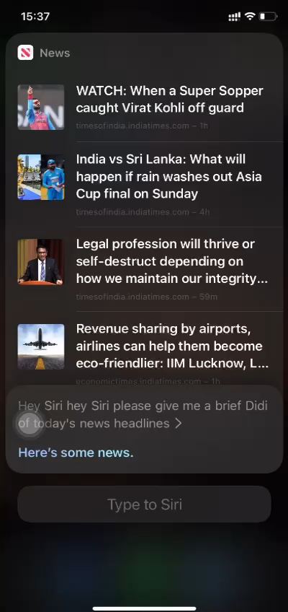
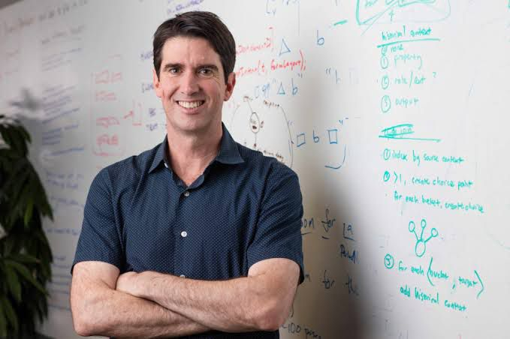
Its artificial intelligence mechanism recognizes speech, processes it as data, and then responds with an answer or action. Siri can answer questions and fulfill requests, such as reading a text message out loud or playing a song on the device.

Slide 11

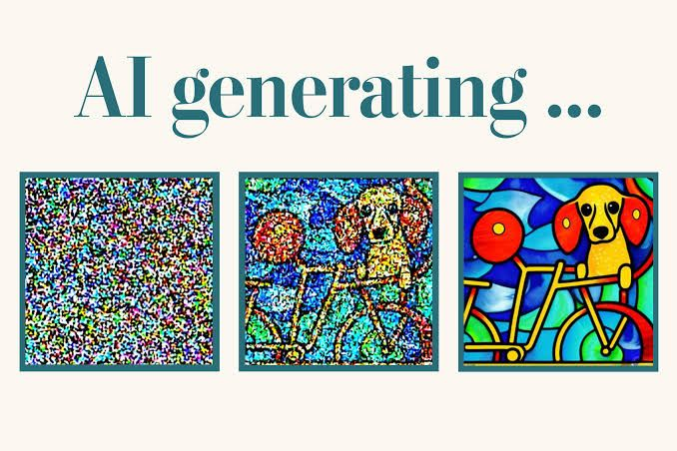
AI-powered tool that takes a text prompt, processes it, and creates an image that best matches the description given in the text prompt.

Slide 12

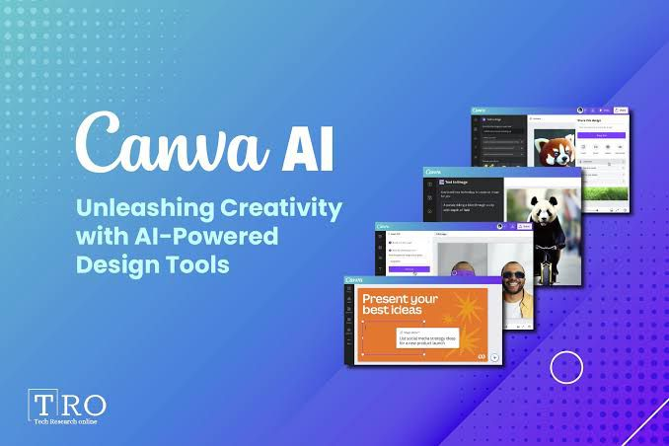


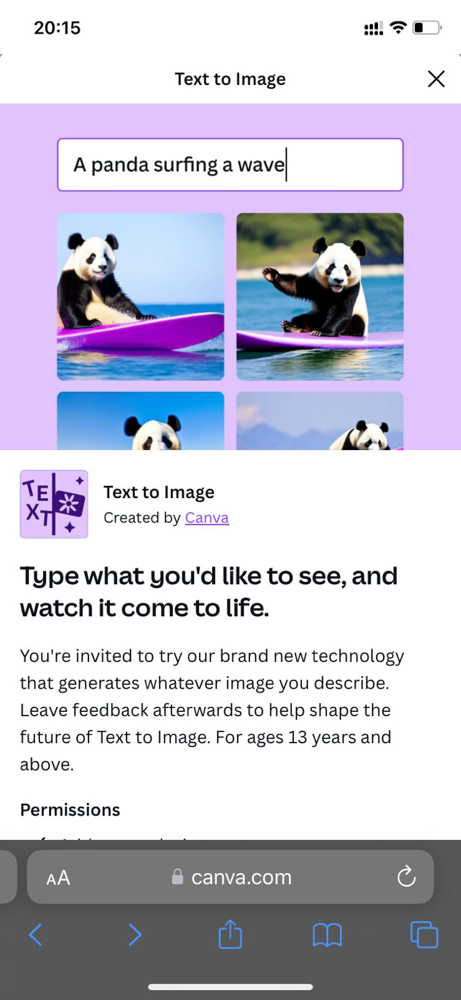
Canva's AI features—including Text to Image, Magic Edit, Magic Design, Presentations, and Beat Sync—are available to all users for free.

Slide 13


PicFinder.AI is an AI-powered image generator that enables users to unleash their creativity and bring their vision to life.

Slide 14
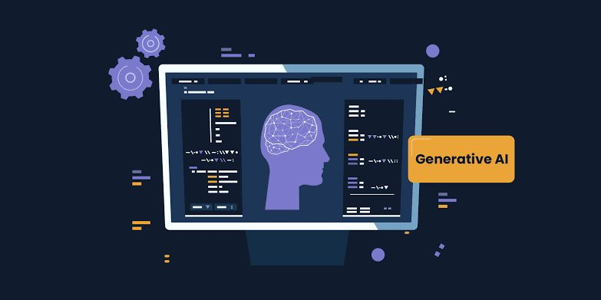
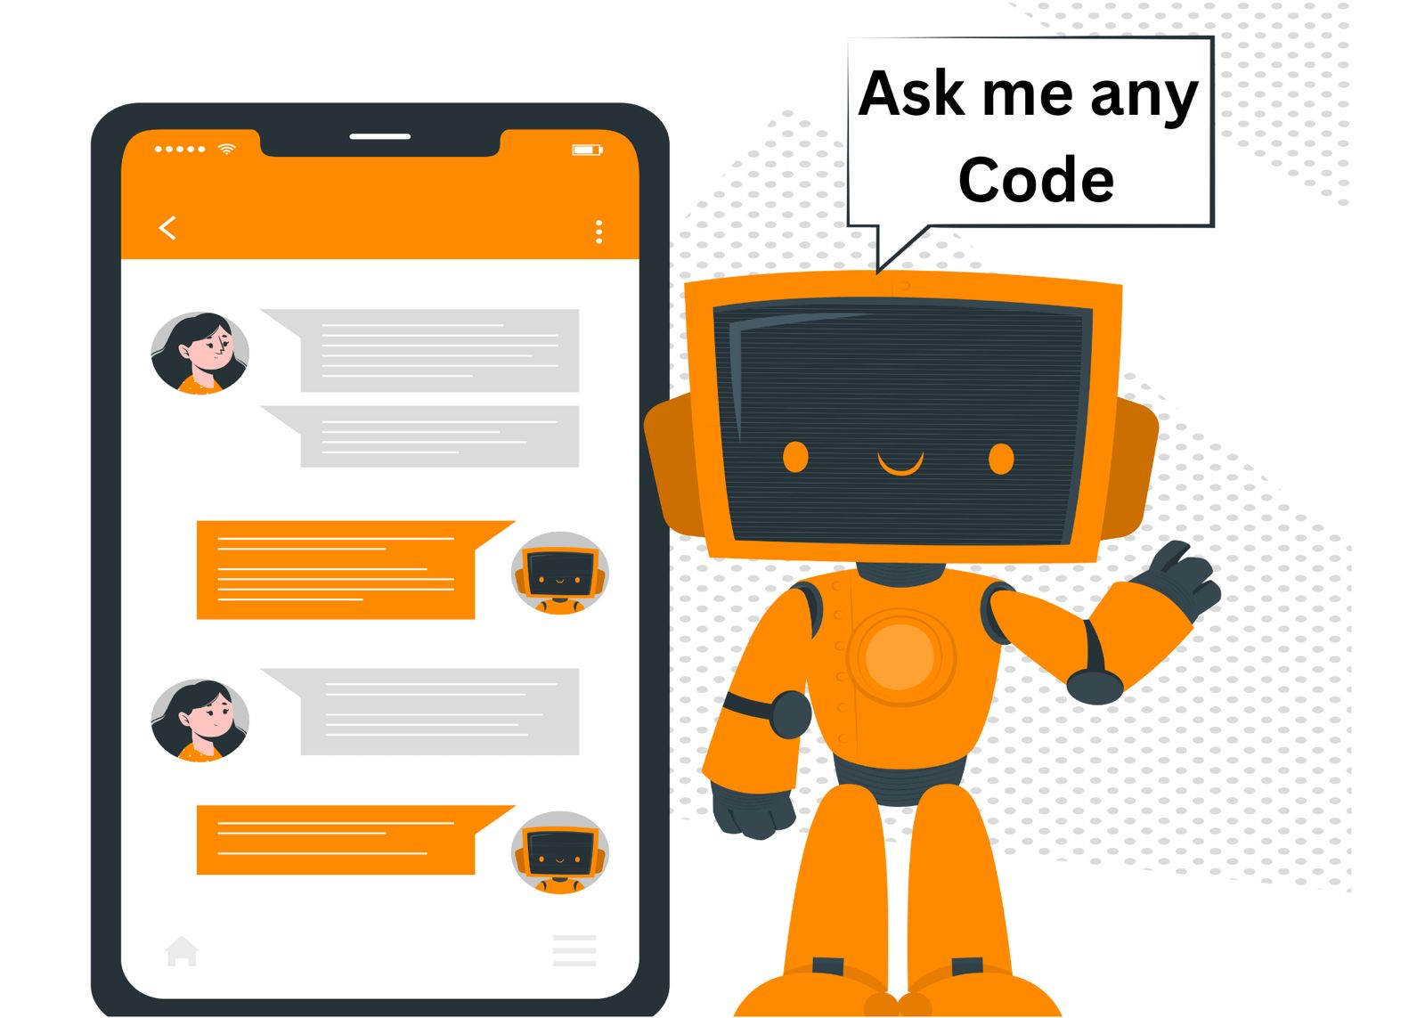
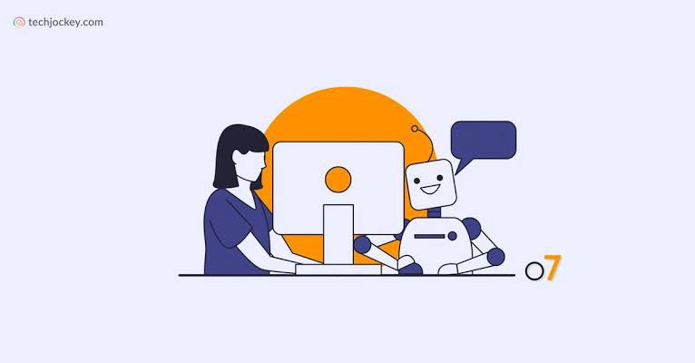
AI-driven code generators leverage machine learning and natural language processing to understand user requirements and generate code.

Slide 15

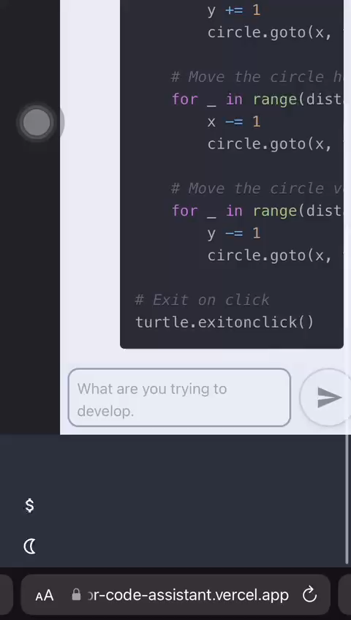
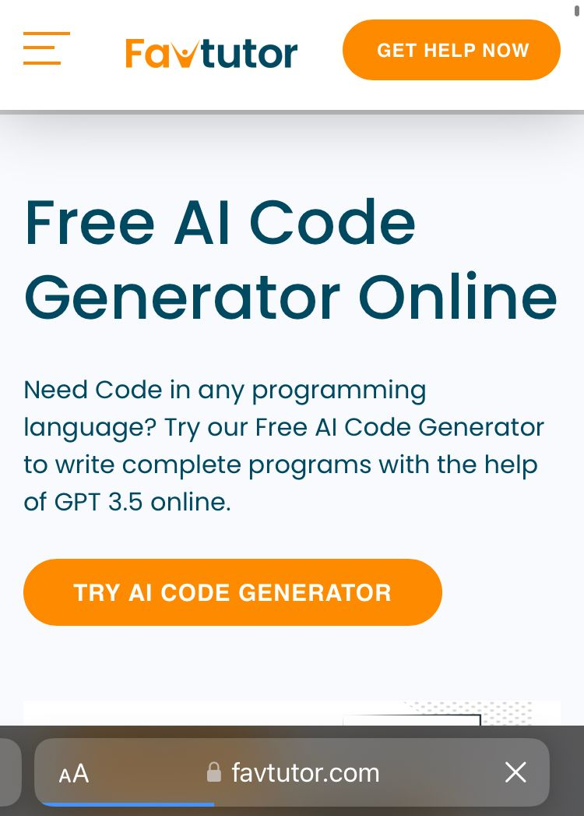
FavTutor is an trusted online tutoring service to connect students to independent tutors and provide guidance on Computer Science subjects like Java, Python, C, C++, SQL, Data Science, Machine Learning, Statistics, and many others.

Slide 16

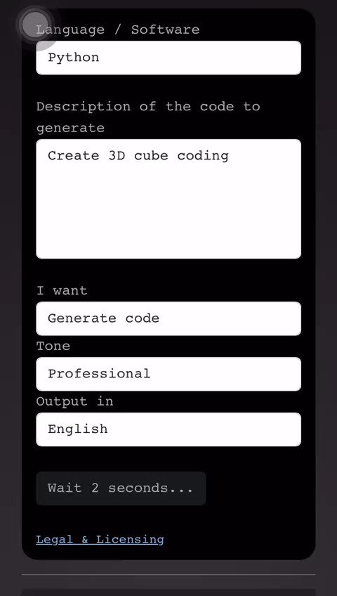
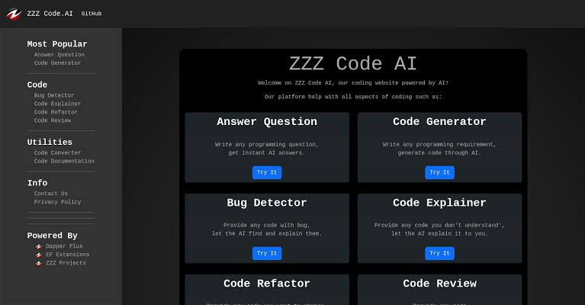
ZZZ Code AI is an AI-powered coding website that provides several tools to assist users with various aspects of coding.

Slide 17
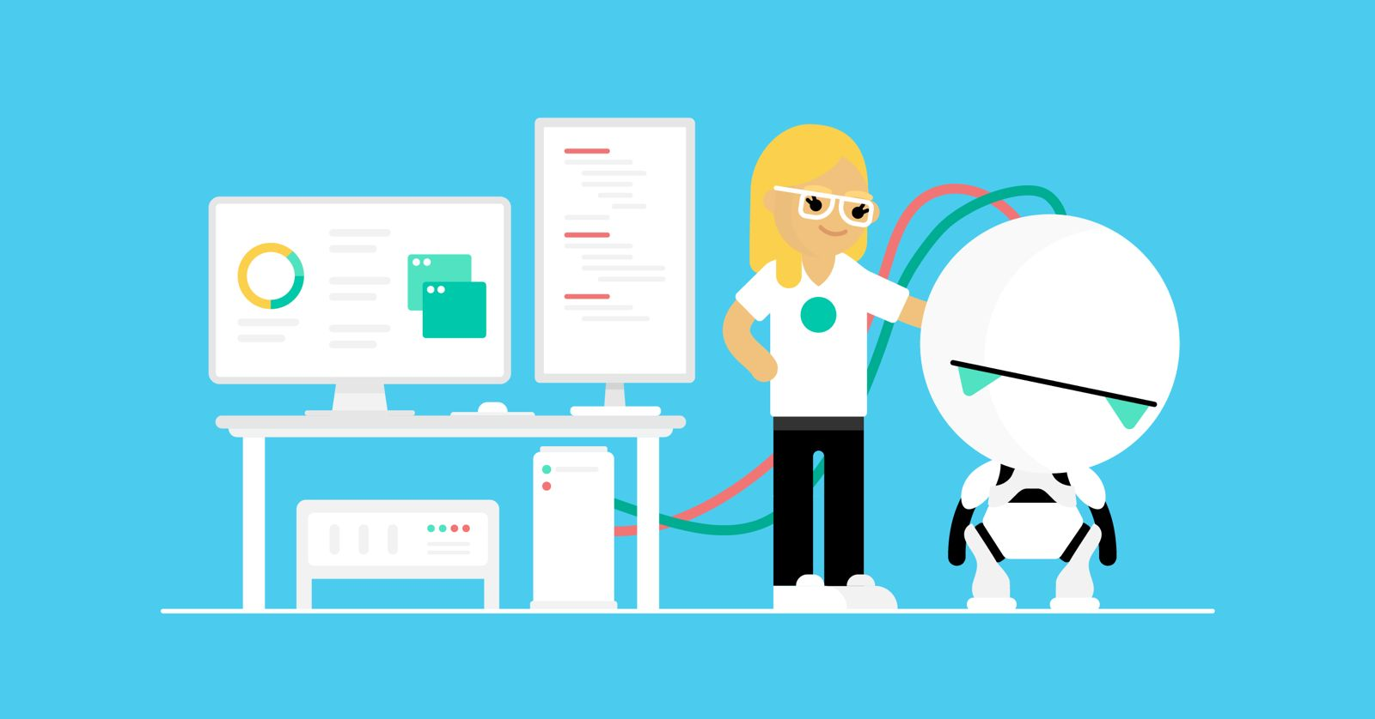
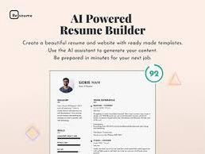
powered resume builder to automatically generate your entire resume.

Slide 18

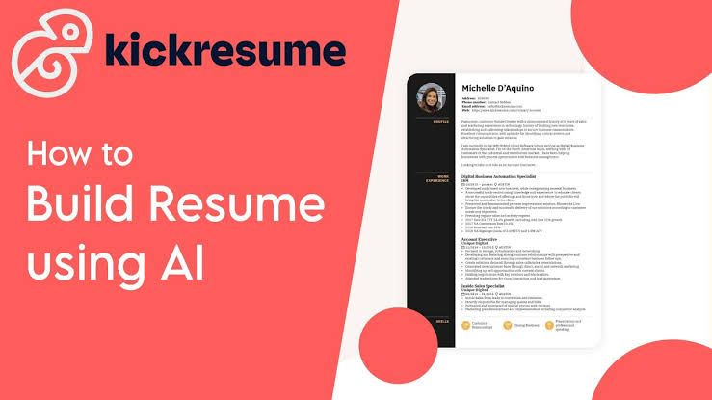
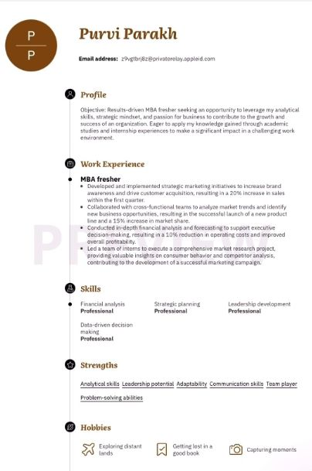
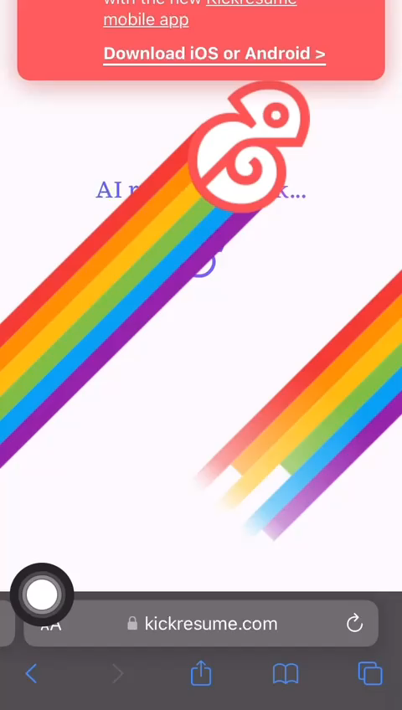
Kickresume AI Resume Builder is based on OpenAI's GPT-3 neural network, which is the world's most powerful natural language processing model.

Slide 19


“Chat with PDF" tool, powered by OpenAI, lets you chat with your PDF documents and helps you read, comprehend and summarize your documents online using artificial intelligence technology.’

Slide 20

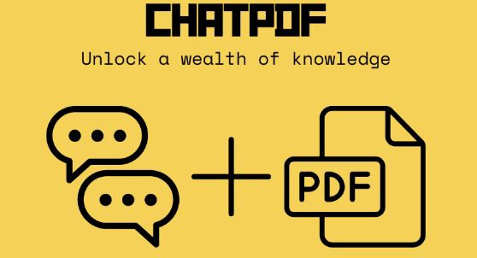
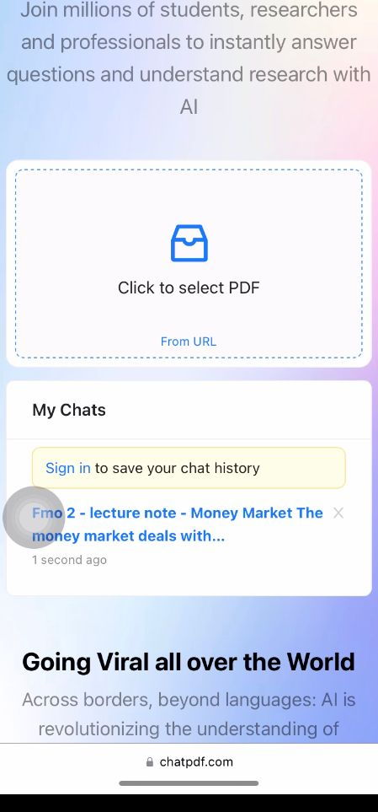
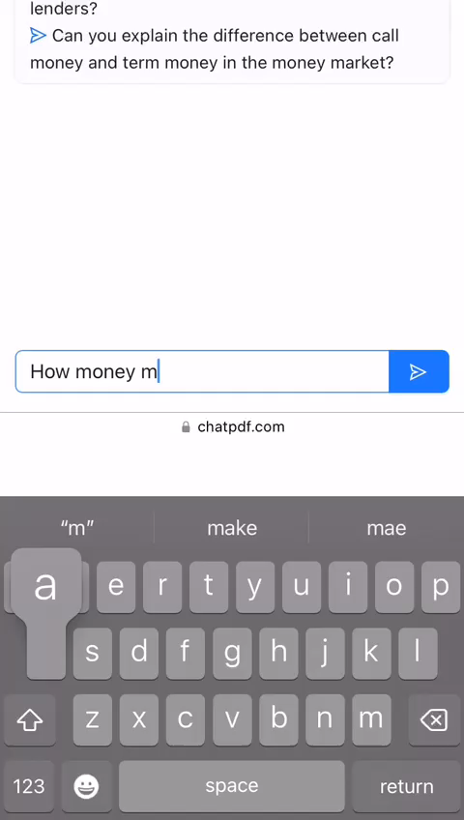
ChatPDF is an AI tool that enables users to chat with a PDF document in a conversational format.
Mathis Lichtenberger is the Founder at ChatPDF .

Slide 21

conclusion
In conclusion, while artificial intelligence (AI) has the potential to transform education by improving student learning outcomes, increasing access to education, and providing real-time feedback to educators, AI leads to transformative applications within a series of industrial, intellectual, and social applications, far beyond those caused by previous industrial revolutions. Furthermore, AI has proven to be superior to human decision-making in certain areas.
List of some ai tools used in above slides.

